Slide 1
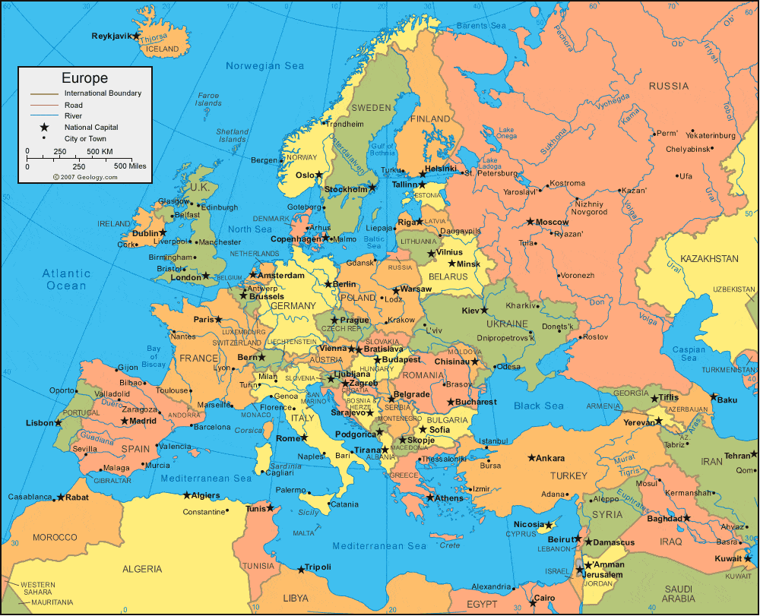
ERASMUS 2018-2020
CYPRUS GREECE TURKEY SLOVAKIA SPAIN

Slide 2
ERASMUMS
CYPRUS

Slide 3
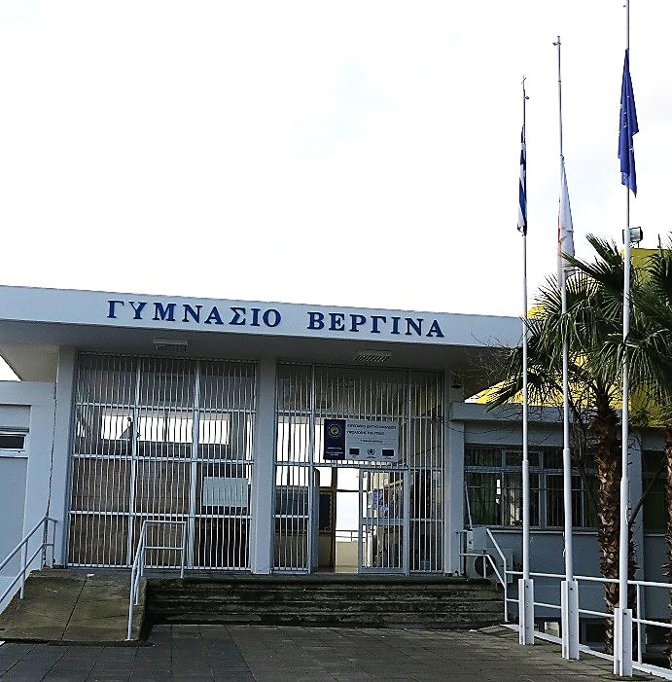
VERGINA GYMNASIUM LARNACA
Notes:
The entrance of our school.

Slide 4
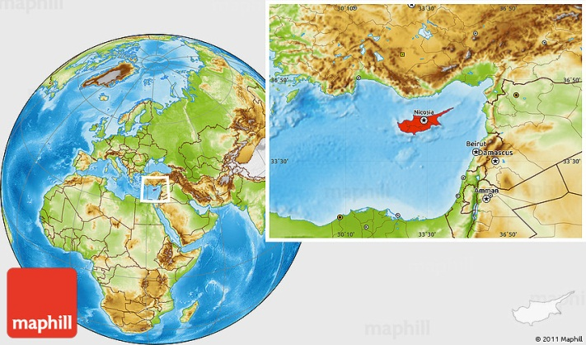
The Republic of Cyprus
Cyprus is an island in the Eastern Mediterranean,
It is located between Europe, Asia and Africa.
Cyprus is the third largest island in the Mediterranean
It has a population of around 1 million.
Notes:
Cyprus is an island in the Eastern Mediterranean,
It is located between Europe, Asia and Africa.
Cyprus is the third largest island in the Mediterranean
It has a population of around one million.

Slide 5
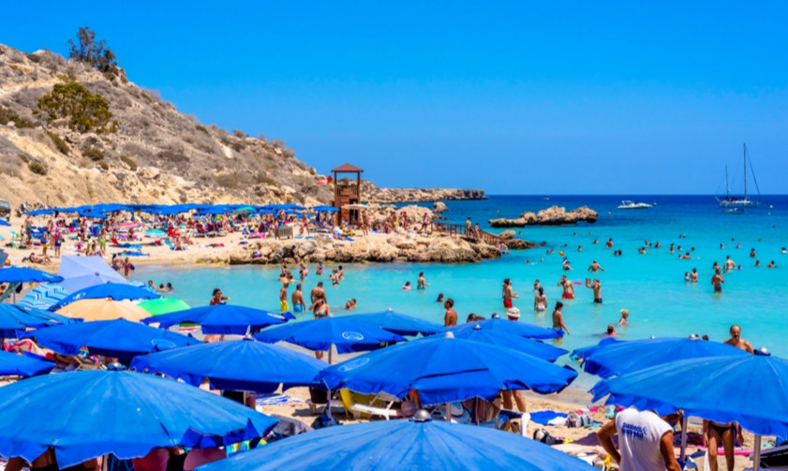
Cyprus- The island of Aphrodite
Cyprus is the island of love, the island of Aphrodite.
It is located 900 Km southeast of Greece,
400Km from Rode island and only 100 Km south of Turkey.
It is west of Syria and Lebanon
Notes:
Cyprus is the island of love , the island of Afrodite.
It is located nine hundred Kilometers southeast of Greece ,
four hundred Kilometers from Rode island and only one hundred Kilometers south of Turkey.
It is west of Syria and Lebanon

Slide 6
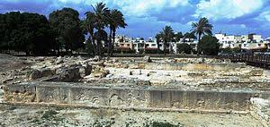
The history of Cyprus
Cyprus has a long history.
Cyprus was settled from 10th millennium BC.
Cyprus was subsequently occupied by the empires of the Assyrians, Egyptians
and Persians from whom the
island was seized in 333 BC
by Alexander the Great.
Notes:
Cyprus has a long history.
Cyprus was settled from tenth millennium BC.
Cyprus was occupied by the empires of the Assyrians, Egyptians
and Persians from whom the island was seized in three hundred thirty three BC
by Alexander the Great.

Slide 7
The Republic of Cyprus
Cyprus became independent in 1960 after the Zurich- London agreement
Notes:
Cyprus became independent in Nineteen sixty after the Zurich- London agreement

Slide 8
On July 15th, 1974 there was a military coup.
This was followed by a Turkish invasion on July 20th 1974
The island and its people remain divided until today.
Notes:
On July fifteen, nineteen seventy four there was a military coup .
This was followed by a Turkish invasion on July twentieth nineteen seventy four.
The island and its people remain divided until today.

Slide 9
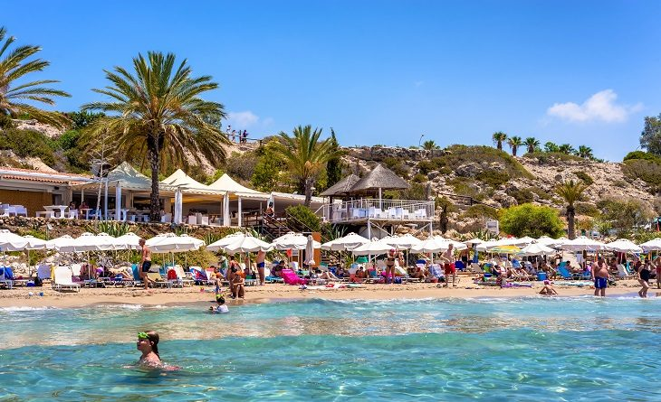
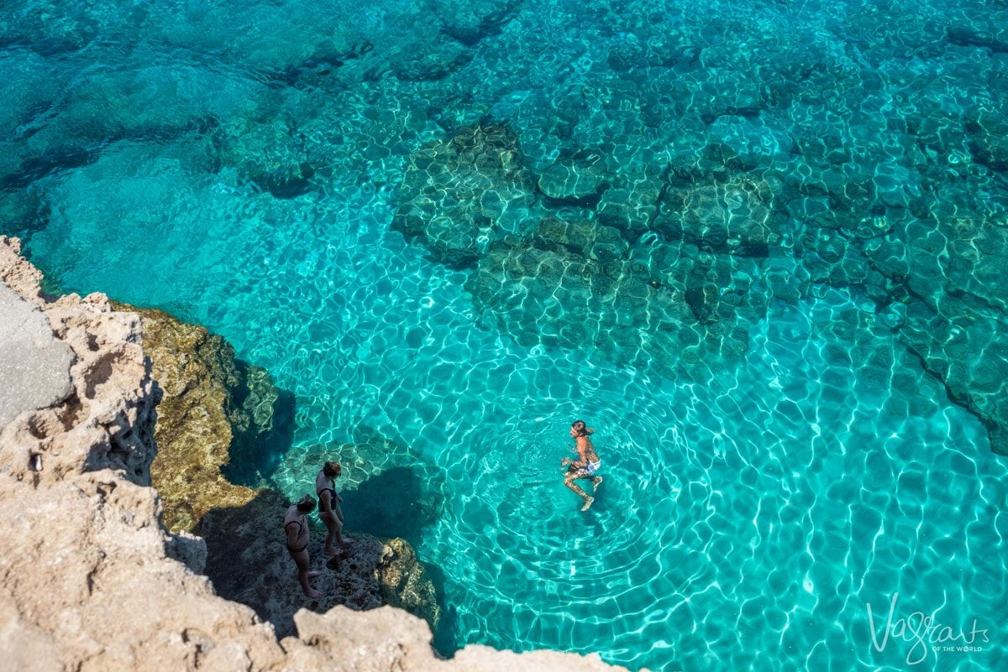
Today
Cyprus became a member of the European Union on
May 1st 2004 and
joined the Eurozone
in 2008.
Cyprus is a major tourist destination in the Mediterranean.
Notes:
Cyprus became a member of the European Union on
May first two thousand four and joined
the Eurozone on
January first two thousand eight.
Cyprus is a major tourist destination in the Mediterranean.

Slide 10
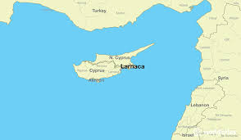
LARNACA
Larnaca is located on the south-eastern coast of Cyprus.
It is the third-largest city in Cyprus, after Nicosia and
Limassol, with a
population of 51,5
thousand
Notes:
Larnaca is located on the south-eastern coast of Cyprus.
It is the third-largest city in Cyprus, after Nicosia and Limassol, with a population of fifty one point five thousand

Slide 11
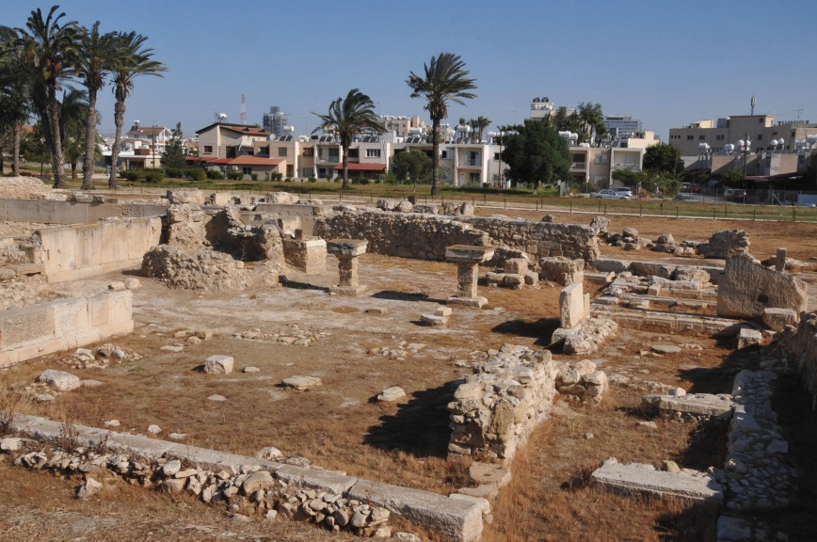
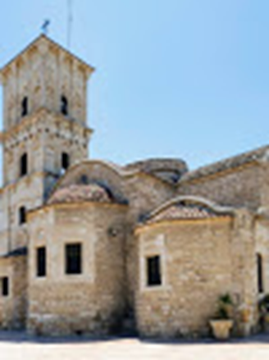
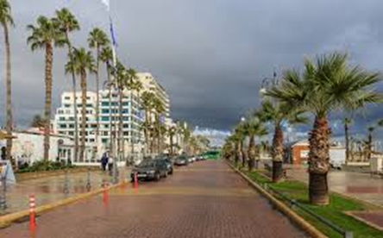
Attractions of Larnaca
Ruins of ancient kition
Saint lazarus church
Phinikoudes sea front
Notes:
The city of Larnaca has a long history.
The 9th century church of Saint Lazarus is perhaps the best known monument in Larnaca.
The ruins of ancient Kition can be seen near the center of the city.
Phinikoudes is named after the many palm trees there and is one of the main attractions in larnaca

Slide 12
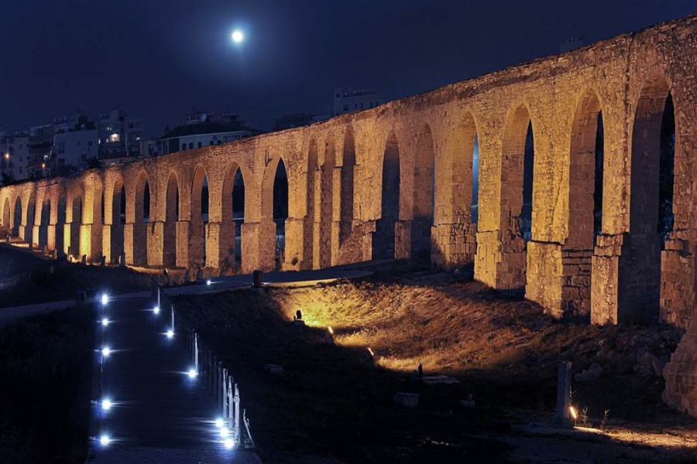
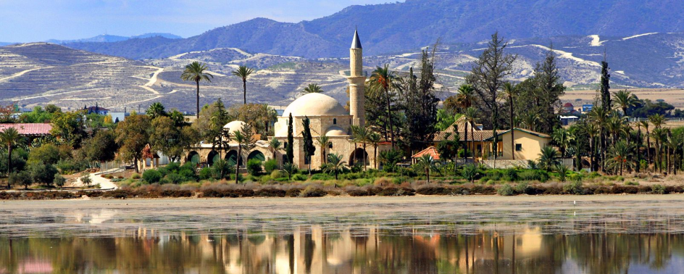
Other monuments include
the Kamares aqueduct (built by the Romans and extended by the Ottomans),
the Hala Sultan Tekke (a Muslim pilgrimage)
the medieval seafront castle.
Notes:
Other monuments include
the Kamares aqueduct,
the Hala Sultan Tekke and
the medieval sea-front castle.

Slide 13
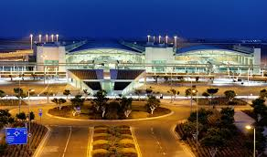
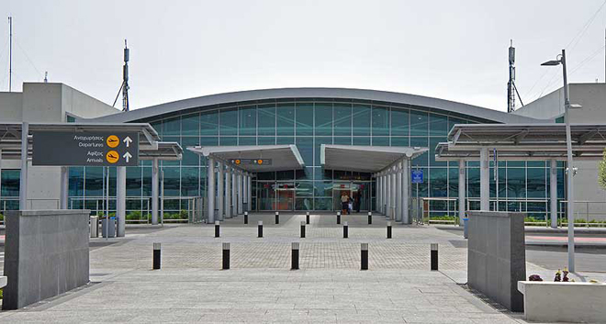
Larnaca is home to the country's primary international airport.
Notes:
Larnaca is home to the country's primary international airport.
It also has a seaport,
a marina and
a small fishing harbour.

Slide 14
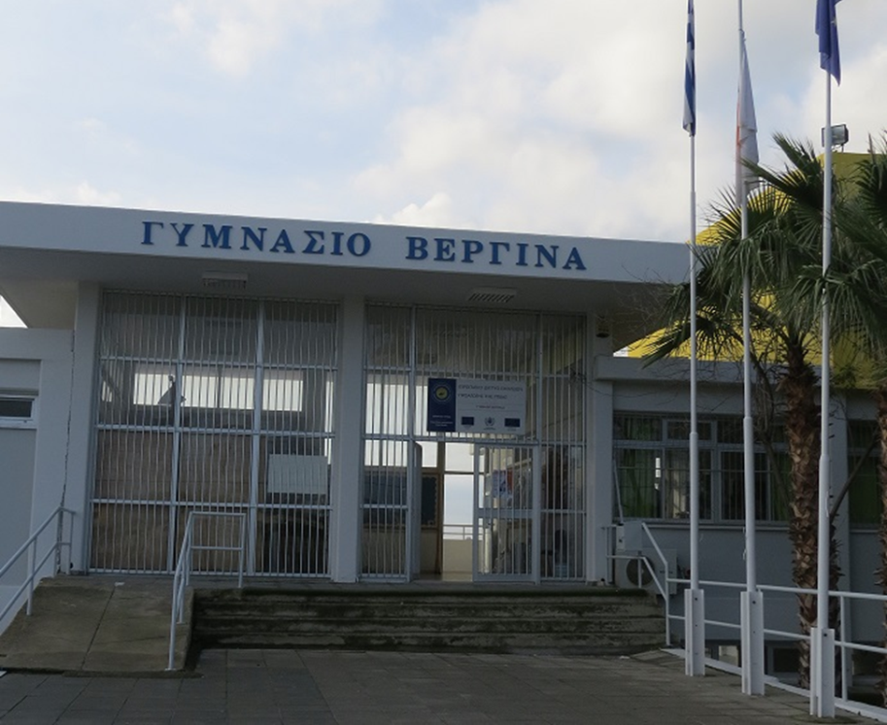
The Vergina Gymnasium
Vergina Gymnasium was founded in September 1995.
It has its name from Vergina town in Central Macedonia in Greece
Notes:
Vergina Gymnasium was founded in September nineteen ninety five.
It has its name from Vergina town in Central Macedonia in Greece

Slide 15
The logo of the school is the vergina star, a sun with 16 radii, that was the symbol of the Macedonian dynasty.
Notes:
The logo of the school is the vergina star, that was the symbol of the Macedonian dynasty.

Slide 16
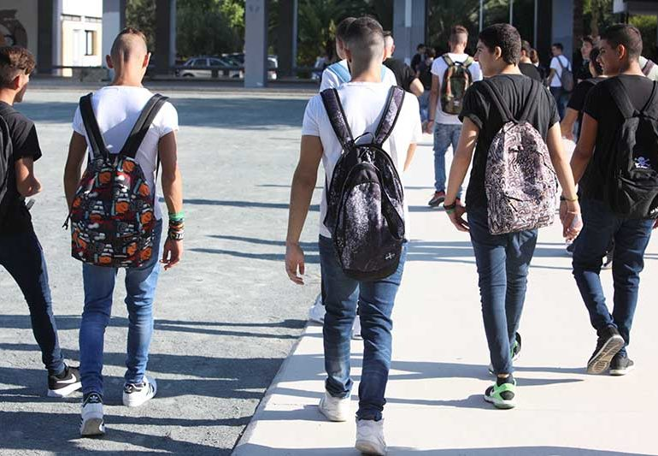
The Vergina Gymnasium
The school has students from the kamares and Vergina regions of Larnaca as well as small villages that are close by.
It also has students from other countries living in Cyprus.
Notes:
The school has students from the kamares and Vergina regions of Larnaka as well as small villages that are close by.
It also has students from other countries living in Cyprus.

Slide 17
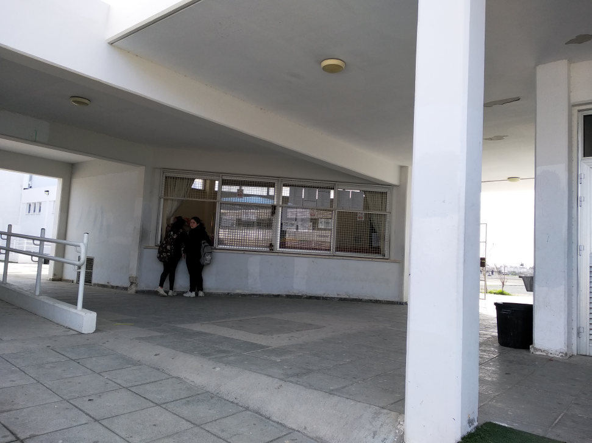
The School Canteen
One of the objectives of the school canteen in Cyprus is to promote a healthy eating culture among students, since it is believed that a healthy diet is a crucial factor in teenagers lives.
Notes:
One of the objectives of the school canteen in Cyprus is to promote a healthy eating culture among students, since it is believed that a healthy diet is a crucial factor in teenagers lives.

Slide 18
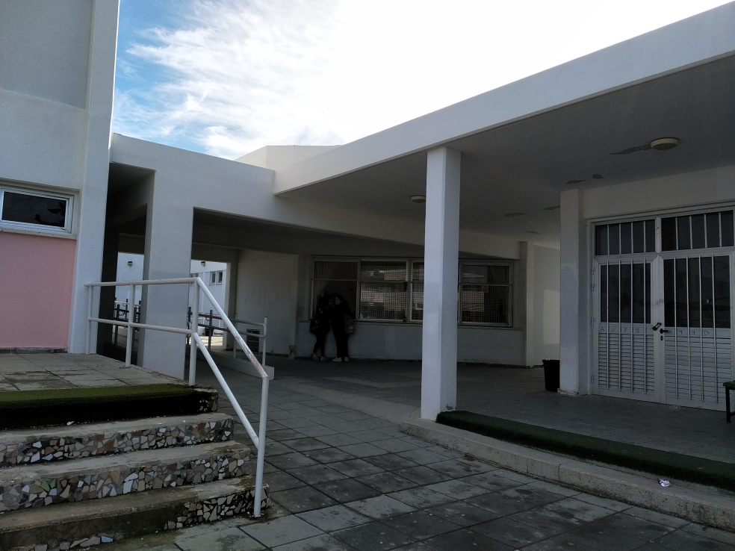
The school canteen has many available healthy snacks to choose from such as nuts, cereal bars, rice crackers and pop corn.
Notes:
The school canteen has many available healthy snacks to choose from such as nuts, cereal bars, rice crackers and pop corn.

Slide 19
Pyramid of the Mediterranean diet
Notes:
The Mediterranean diet is based on the diets of people from Greece, Cyprus and Southern Italy.
it has become popular because it promotes good health. The Mediterranean diet profile focuses on whole grains, good fats (fish, olive oil, nuts etc.), vegetables, fruits, fish, and very low consumption of any non-fish meat.

Slide 20
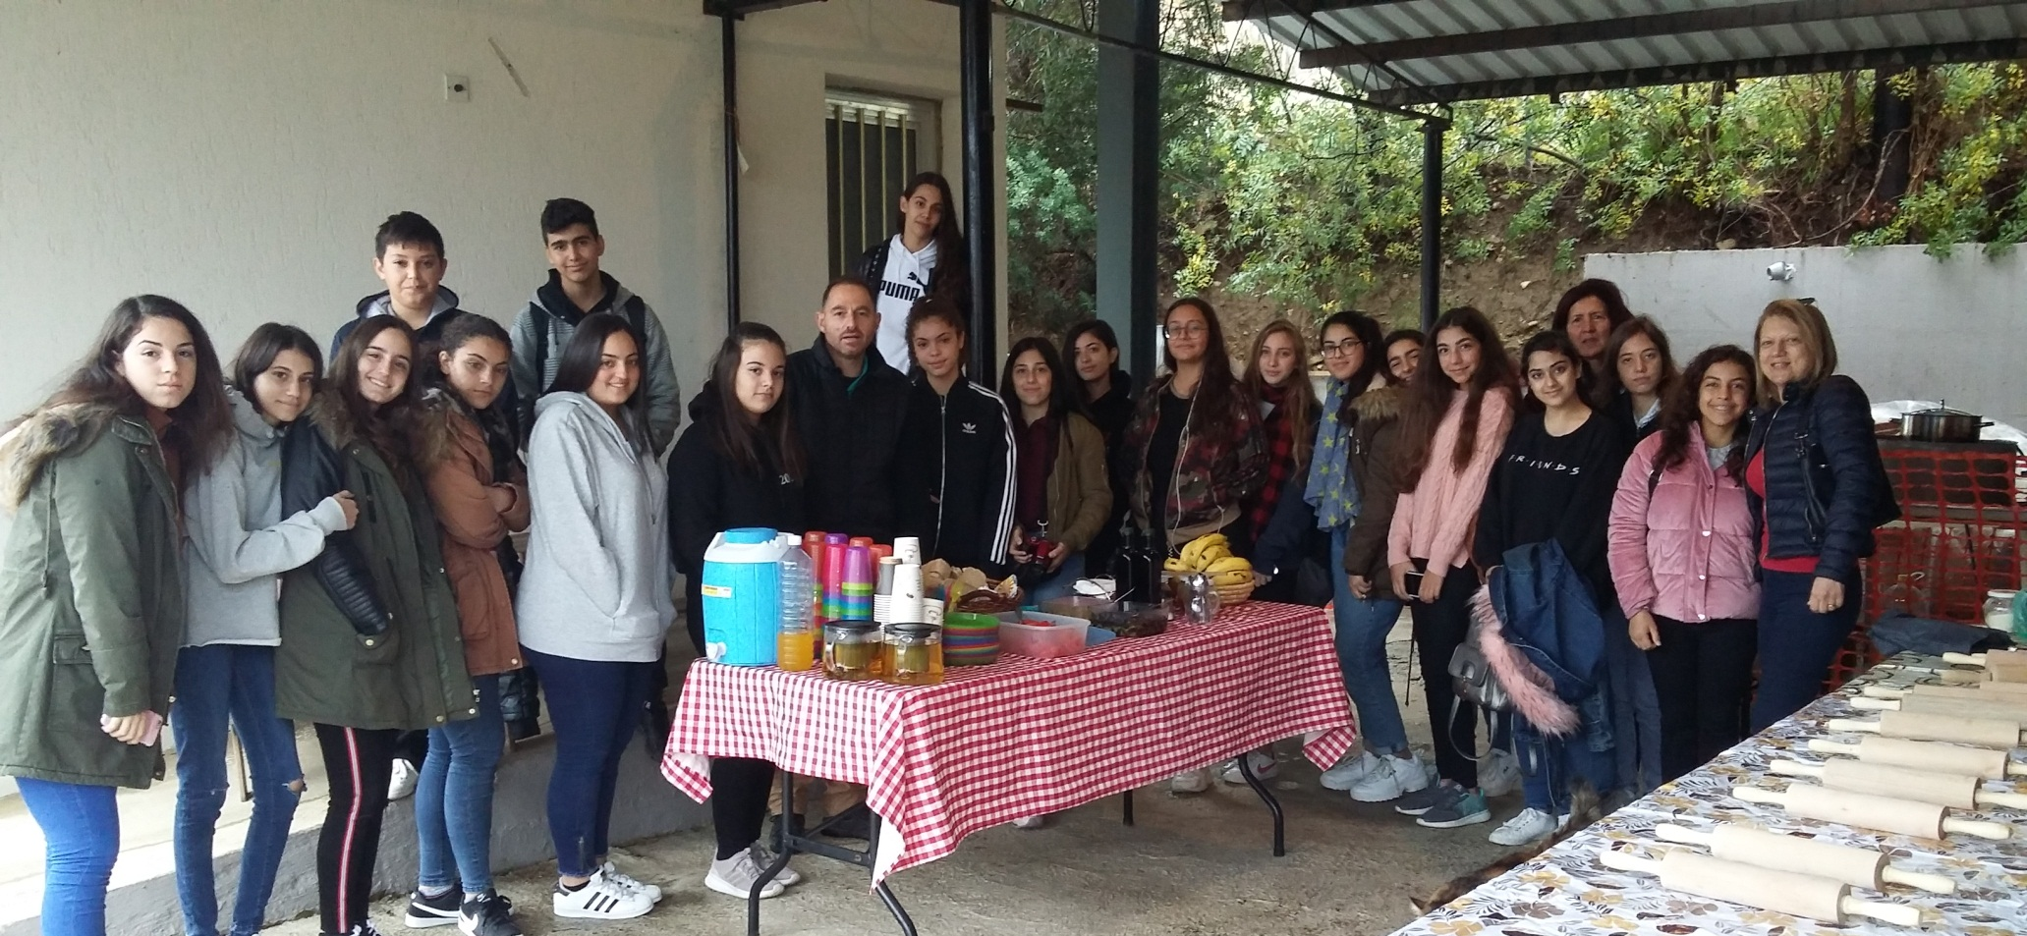
THE CYPRUS ERASMUS+ GROUP
Notes:
THE CYPRUS ERASMUS + GROUP

Slide 21
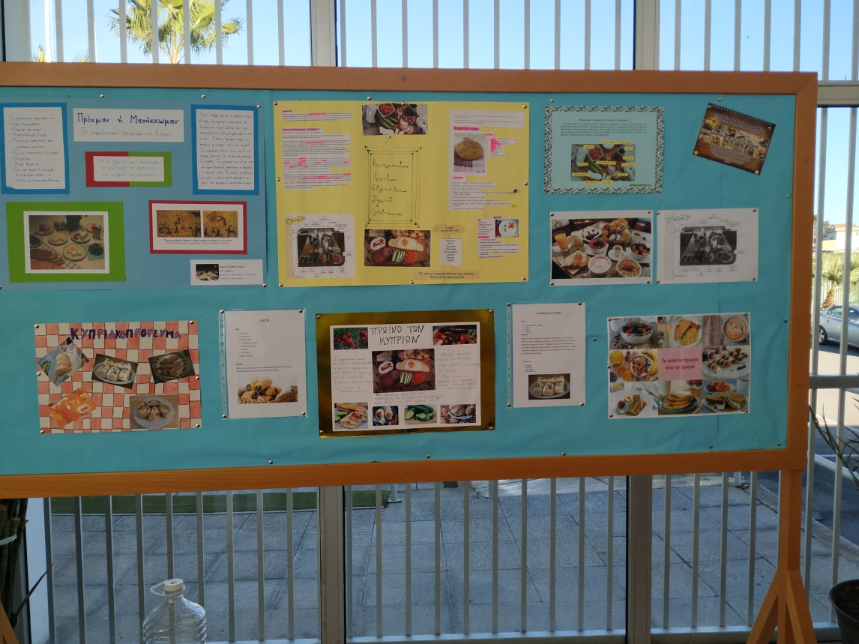
ACTIVITIES IN SCHOOL
Creation of a board
Small videos
Recipes
Logo contest
Posters
Trips
Notes:
ACTIVITIES IN SCHOOL
Creation of a board
Small videos
Recipes
Logo contest
Posters
Trips

Slide 22
LOGO CONTEST
The logo that won by Riana kalogerakou
Notes:
The logo that won by Riana kalogerakou

Slide 23
Other logos:
Notes:
Other logos

Slide 24
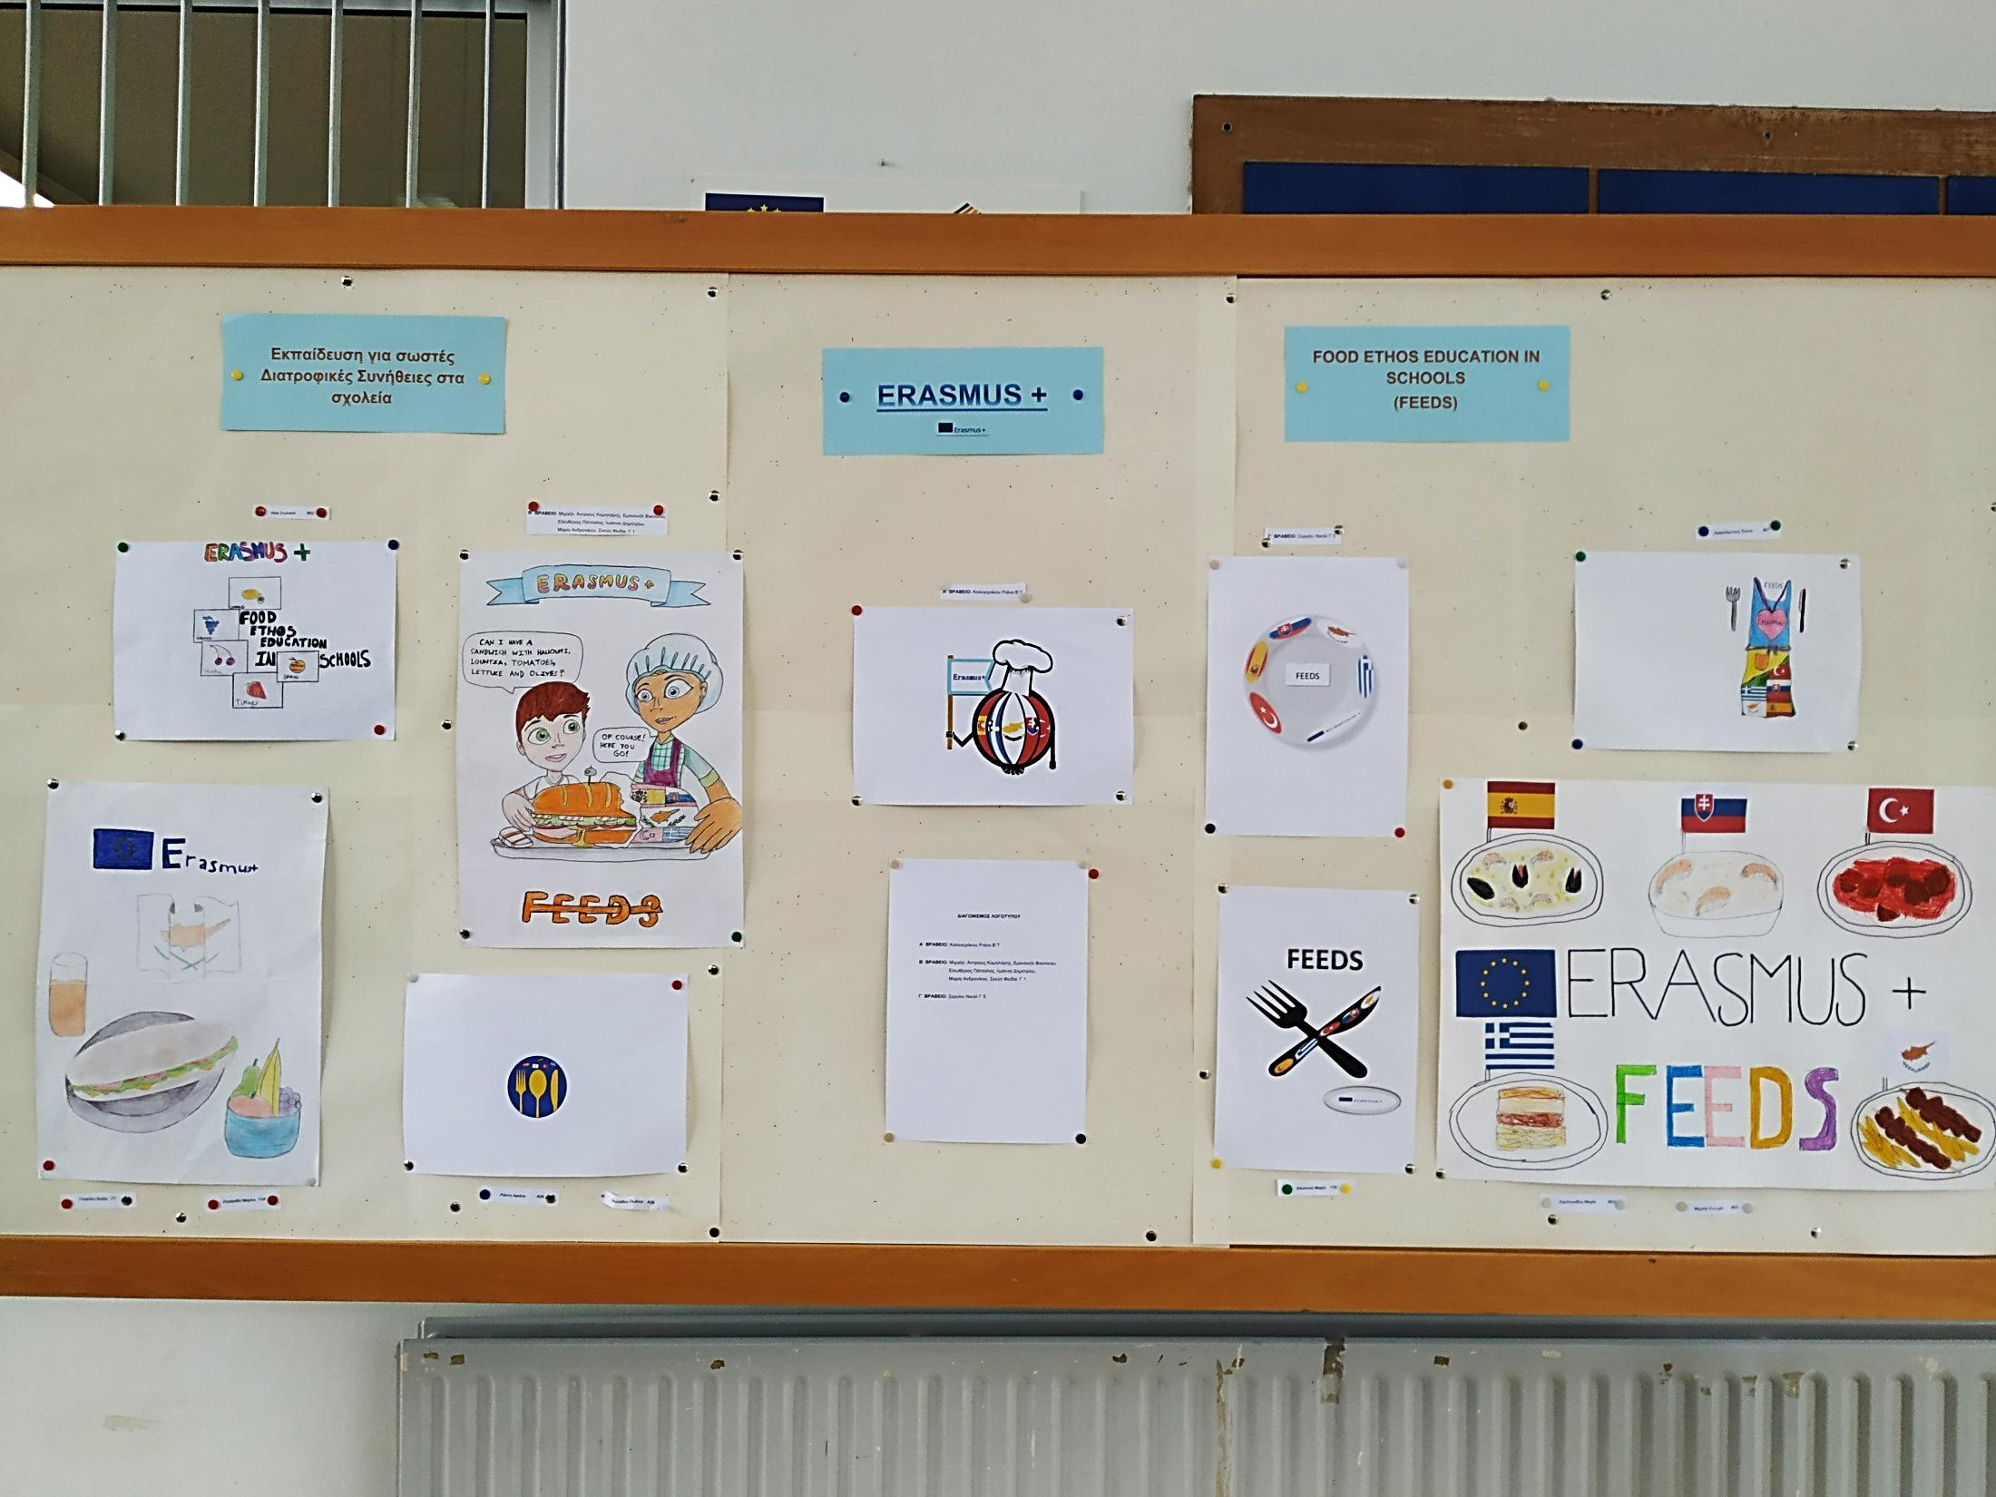

Slide 25
ACTIVITIES!

Slide 26
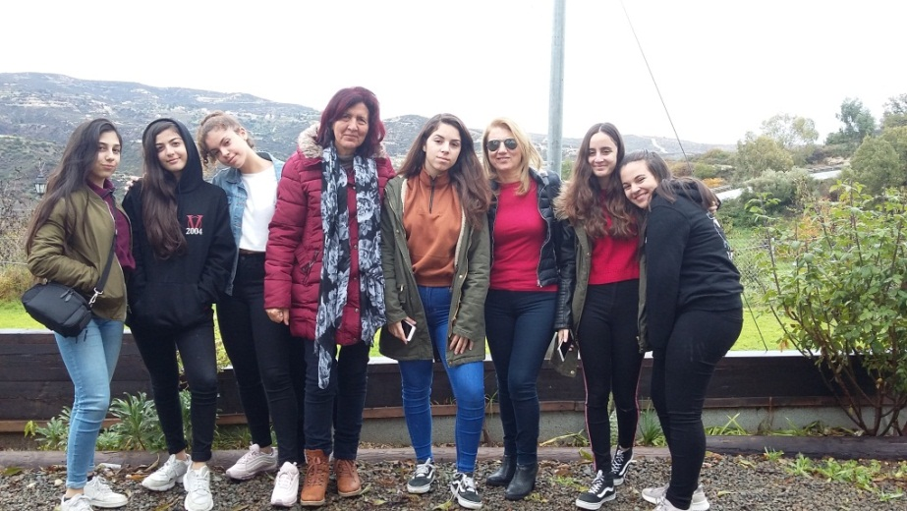
A trip to Vavla
We took a trip to vavla, a small village in Cyprus famous for its natural organic honey.
There, we were offered breakfast and they talked to us about bees and honey production.
They pointed out why bees are probably the most important animals on earth.
They also showed us bee wax and they explained the way the make honey and how they sell it.
Notes:
We took a trip to Vavla, a small village in Cyprus famous for its natural organic honey.
There, we were offered breakfast and they talked to us about bees and honey production.
They pointed out why bees are probably the most important animals on earth.
They also showed us bee wax and they explained the way the make honey and how they sell it.

Slide 27
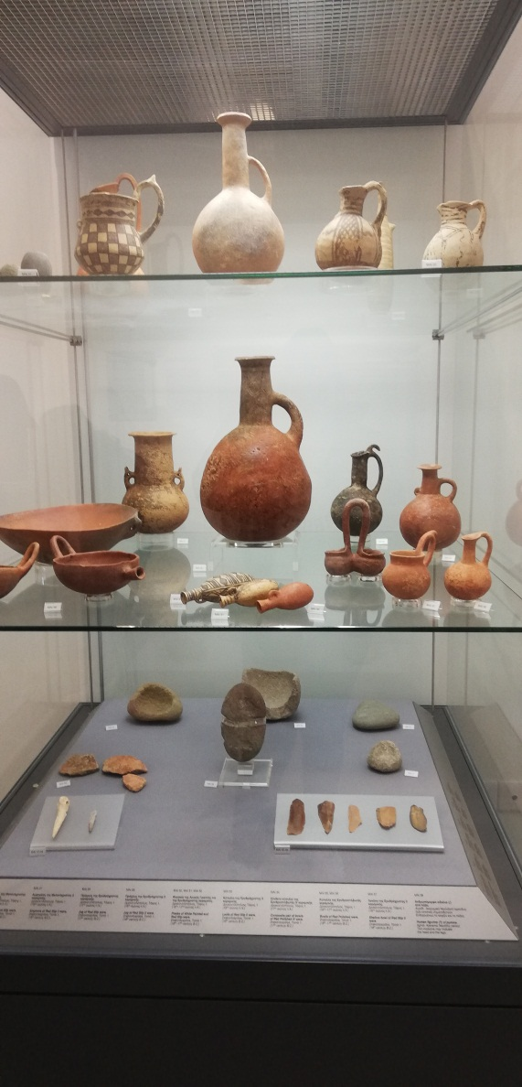
A trip to Ancient Idalion
Through this excursion we have learned that the ancient people have been engaged in fishing, livestock farming, and agriculture by domesticating the sheep from which they used the wool that existed in the animal's skin to make their clothes.
Notes:
Through this excursion we have learned that the ancient people have been engaged in fishing, livestock farming, and agriculture by domesticating the sheep from which they used the wool that existed in the animal's skin to make their clothes.

Slide 28
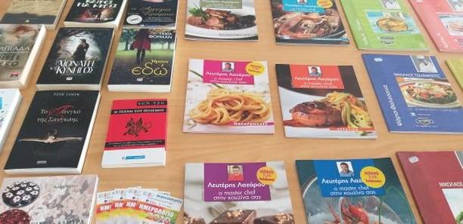
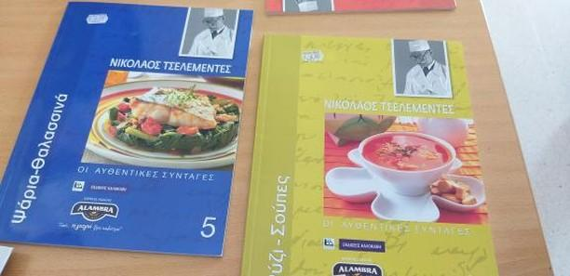
Book excibition
We visited our school's library where a variety of books were exhibited.
There was a vast selection of cooking books filled with delicious recipes, displayed for students to purchase
There was a great response from our classmates who visited the exhibition.
Notes:
We visited our school's library where a variety of books were exhibited.
There was a vast selection of cooking books filled with delicious recipes, displayed for students to purchase
There was a great response from our classmates who visited the exhibition.

Slide 29
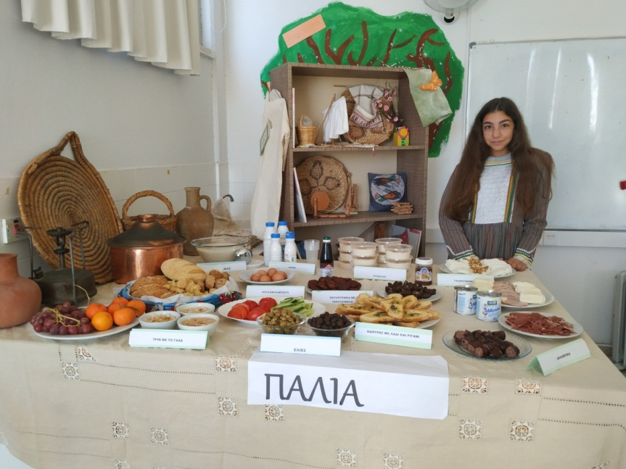
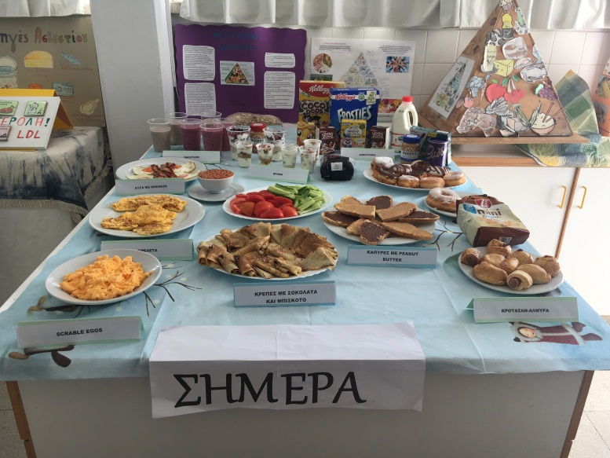
Tratitional vs modern breakfast
We made a traditional and a modern breakfast in order to compare them and we invited the students to enjoy it .
We found that the traditional breakfast is healthier, since it consists of organic and fresh products that were available at the time
Notes:
We made a traditional and a modern breakfast in order to compare them and we invited the students to enjoy it .
We found that the traditional breakfast is healthier, since it consists of organic and fresh products that were available at the time.

Slide 30
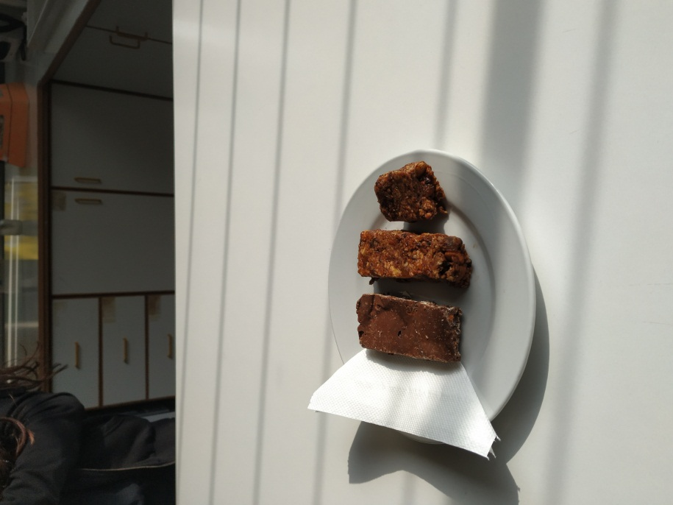
Recipes
To add, we also wrote our own healthy recipes and made them in the home economics lesson.
Notes:
To add, we also wrote our own healthy recipes and made them in the home economics lesson.

Slide 31
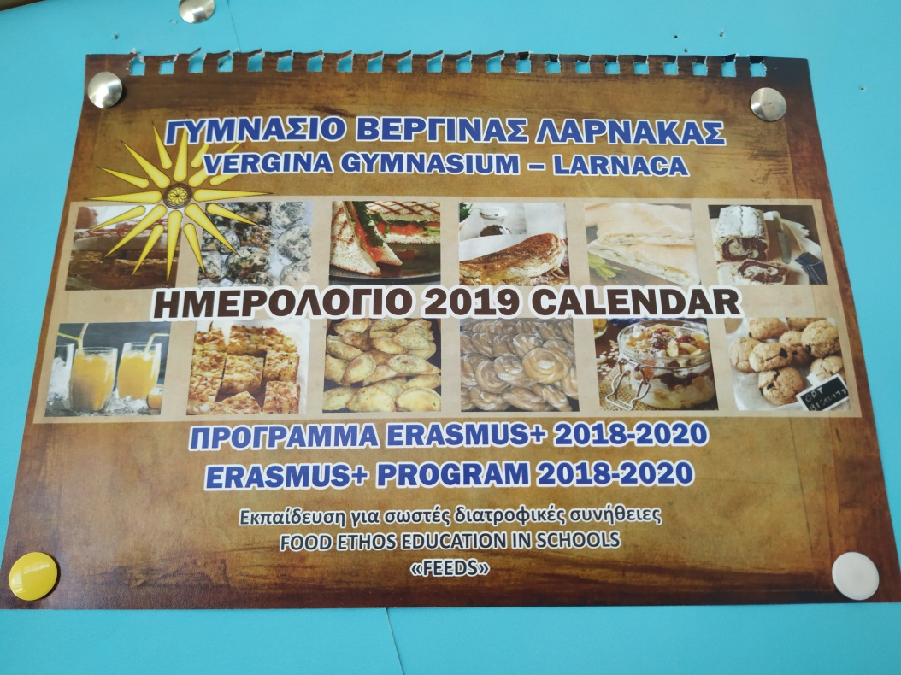
Calendar
We dedicated the school calendar to ERASMUS+
Notes:
We dedicated the school calendar to ERASMUS+

